Slide 1
Fuzzy logic for mobile robot navigation
Ben Church

Slide 2
Content
Mobile robot navigation overview
Navigation as behavior
Crisp navigation
Behavior analysis
Implementation
Fuzzy navigation
Behavior modelling
Approaches

Slide 3
Mobile robot navigation overview

Slide 4
Navigation analysis
Navigation is iterative, closed-loop
Perception
Modelling
Behavior
Environment

Slide 5
Navigation analysis
Environment determines behavior
Environment
Behavior
https://i.makeagif.com/media/1-22-2016/RbtuUx.gif
https://upload.wikimedia.org/wikipedia/commons/2/22/Spur_gears_animation.gif

Slide 6
Environment
Navigation involves variably general environments
Unknown, dynamic
Unknown, static
Known

Slide 7
Behavior objective
Continuous operation
Start to end navigation
http://thesweethome5.wpengine.netdna-cdn.com/wp-content/uploads/sites/3/2016/02/03-robot-vacuum-roomba-path-630.gif
https://i.kinja-img.com/gawker-media/image/upload/s--ttt8ckgm--/c_scale,f_auto,fl_progressive,q_80,w_800/1925wnay9ee3ugif.gif

Slide 8
Environment & Behavior
Behavior model dictated by environment
Reactive
Mechanistic
Unknown, dynamic
Unknown, static
Known

Slide 9
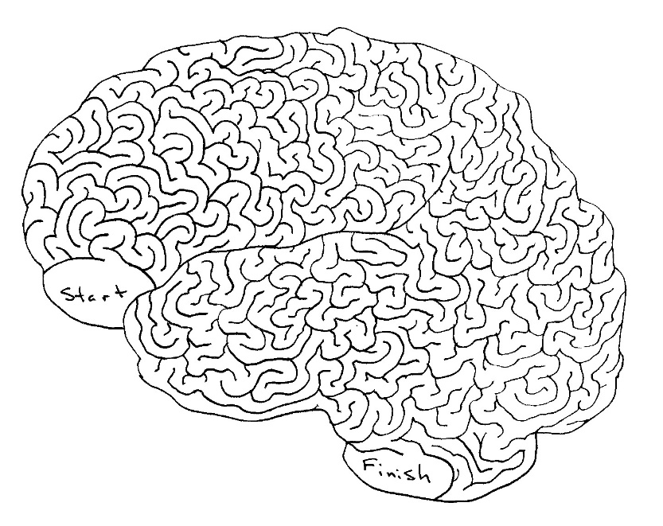
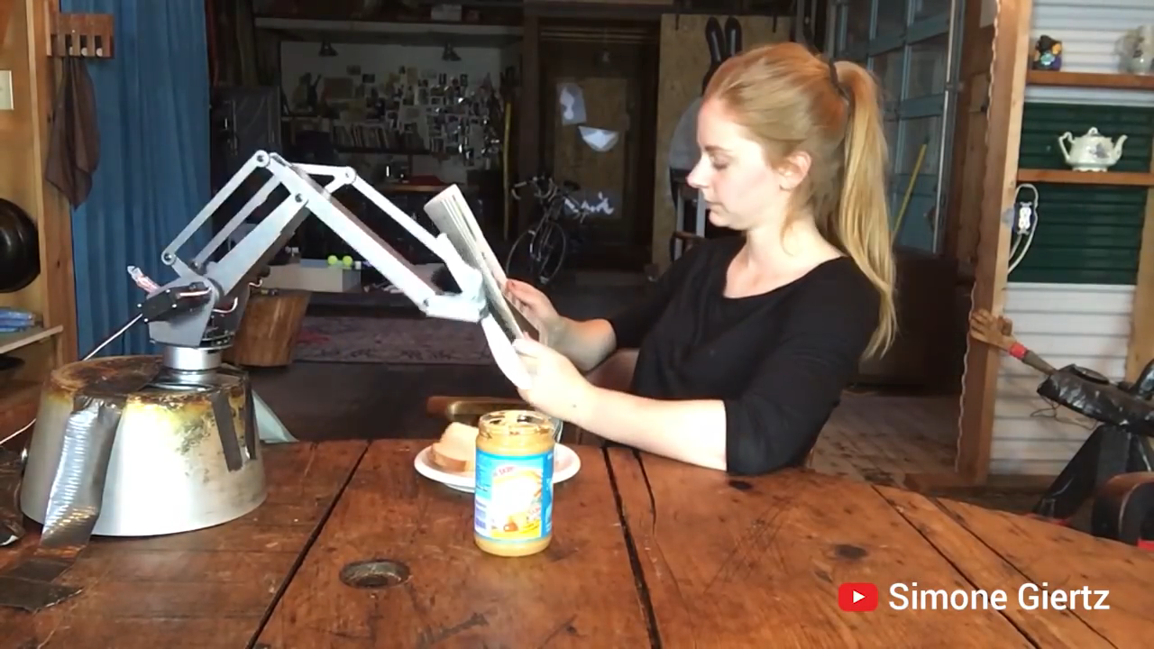
Known - Mechanistic
Model
Behavior
Robot contains environment representation
Open-loop
Unusable in practice
Perception
Modelling
Behavior
Environment
http://braininjurysociety.com/wp-content/uploads/maze.jpg
https://www.youtube.com/watch?v=9CDbl1Y-JOY

Slide 10
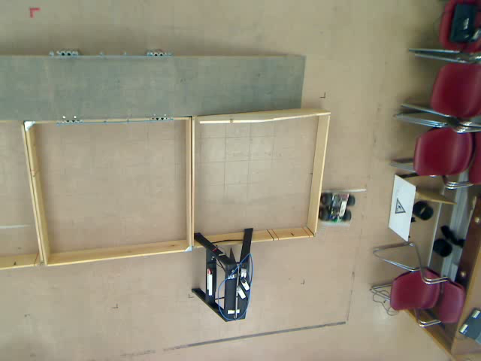
Known - Reactivity
Robot reacts to environmental uncertainty
Used for wall following behavior

Slide 11
Unknown - Reactive
Robots respond to changing environments or disturbances
http://i.imgur.com/ady1DyR.gif
http://i.imgur.com/ZiFuqF9.gif

Slide 12
Navigation as wall-following
Robot is engaged with environment
Environmental measurements guide navigation

Slide 13
General navigation
Closed-loop control
Environment
Behavior
Continuous or start-end
Function of environment
One example: wall-following

Slide 14
Crisp navigation

Slide 15
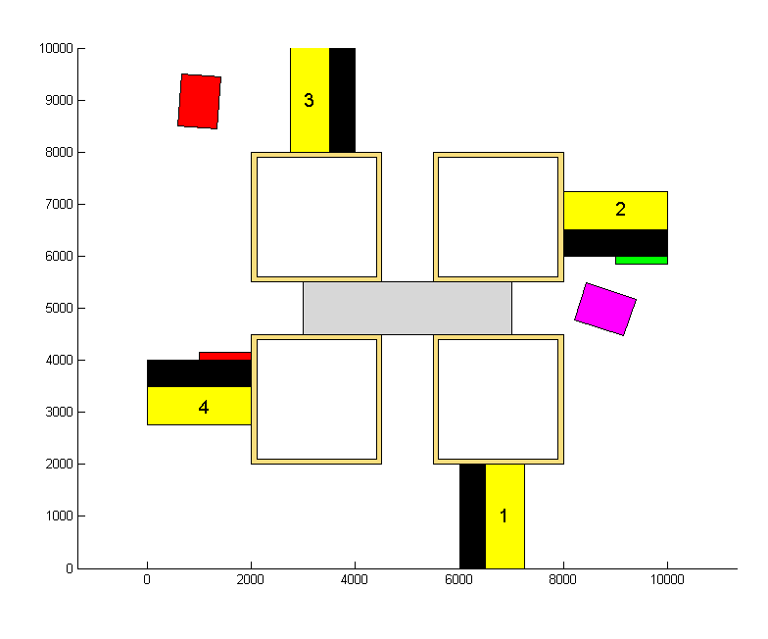
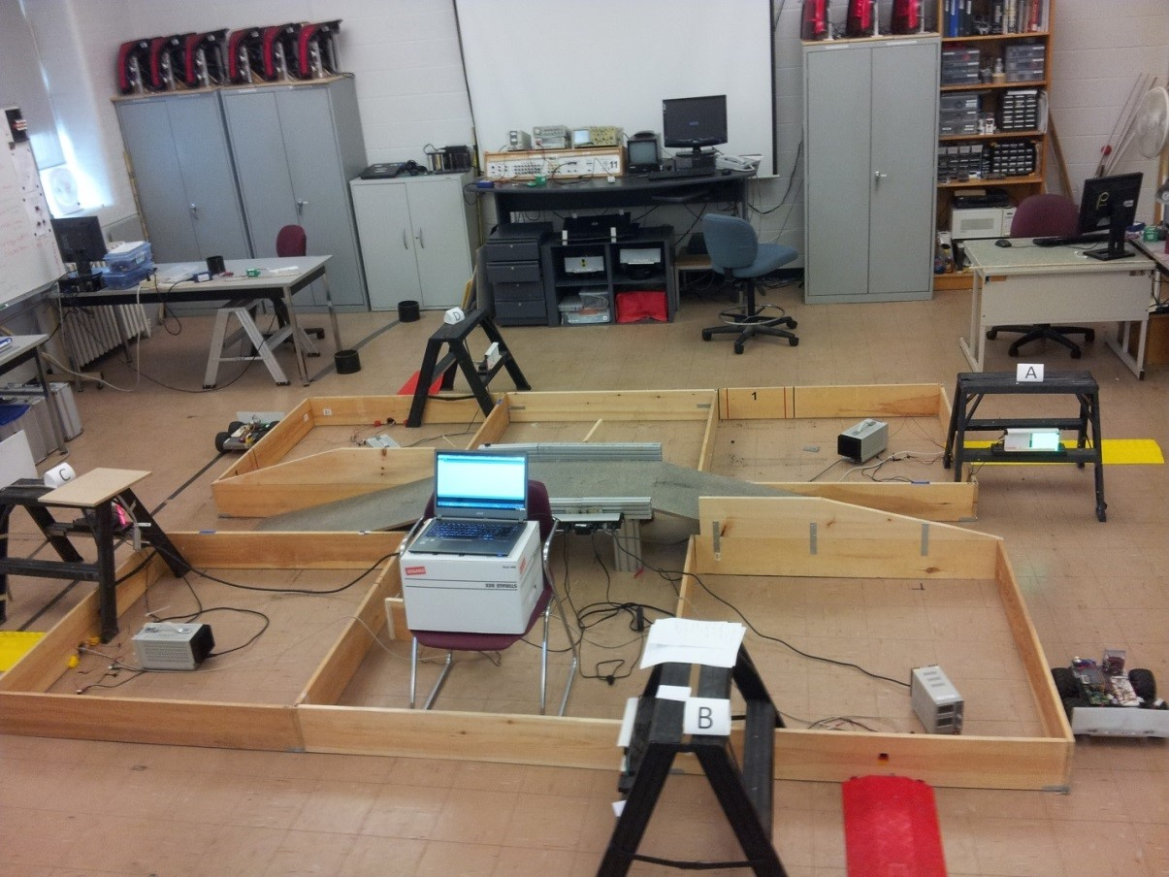
Multiple behaviors
Complex environments require behavior cases
Wall following, gap passing, turning

Slide 16
Multiple behaviors
One behavior at a time
Logical case activation condition

Slide 17
Binary behavior
Such an on-off approach to navigation suitable for known environments
Cannot count through unknown environment

Slide 18
Start-to-end navigation
Unknown environment
Behavior selection no longer a trivial problem

Slide 19
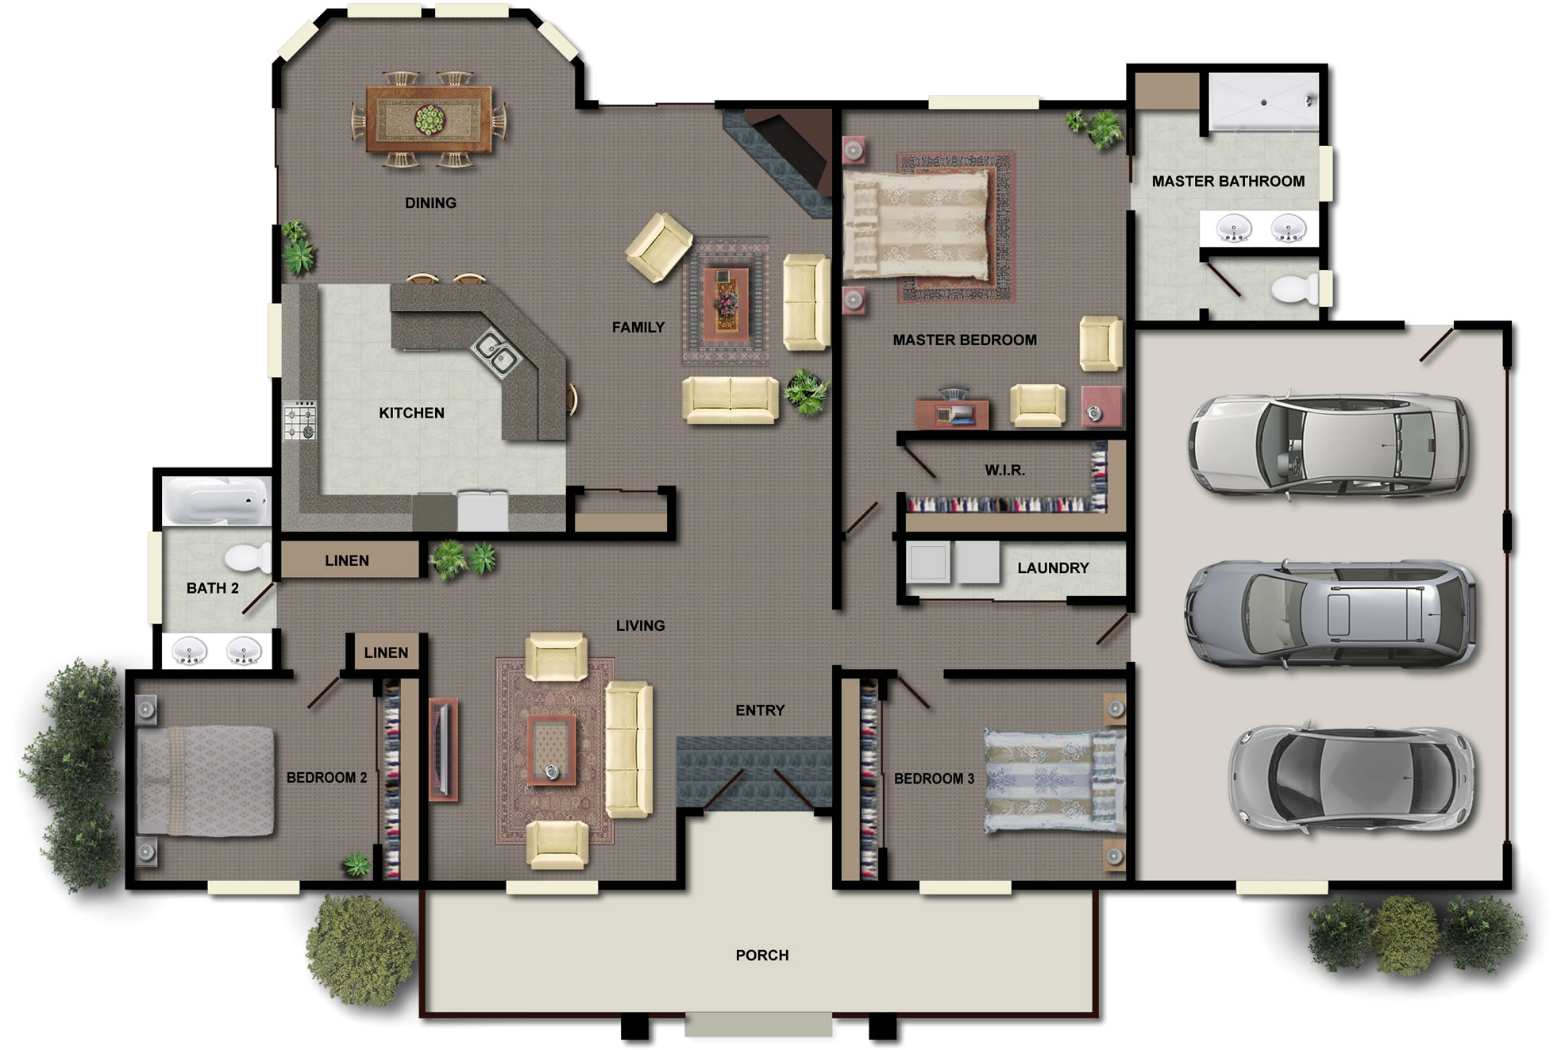
Start-to-end navigation
X
http://houseplans.co.nz/images/house-plans.jpg

Slide 20
More behaviors
End-goal navigation
Based on known goal location and robot heading
Obstacle avoidance
Reactive

Slide 21
Brooks’ subsumption
Brooks [1] selects single most important behavior
High-priority behaviors “subsumpt” others
Explore
Wander
Avoid obstacles

Slide 22
Brooks’ subsumption
Can cause sub-optimal or counter-productive path choice

Slide 23
Rosenblatt and Payton’s voting
Rosenblatt and Payton [2] allow behavior voting
Single best command action chosen
Behavior 1
B₁ × W₁
B₂ × W₂
Vote_{j}
Command_{j}
B₃ × W₃
Behavior 2

Slide 24
Rosenblatt and Payton’s voting
Behaviors were radially arranged headings
Commands corresponding to headings took votes from multiple headings
L
F
R
L
F
R

Slide 25
Arkin’s adding
Arkin [3]* adds each behavior’s direction vectorially
Resorts to Brooks’ subsumption
X
* “Motor Schema Based Navigation for a Mobile Robot: An Approach to Programming by Behavior”

Slide 26
Other approaches
Khatib [4] used potential fields
Althaus and Christensen [5] used nonlinear dynamics

Slide 27
Hierarchies
Mathematical sophistication
Abstraction
Math
Voting
Subsumption
Adding

Slide 28
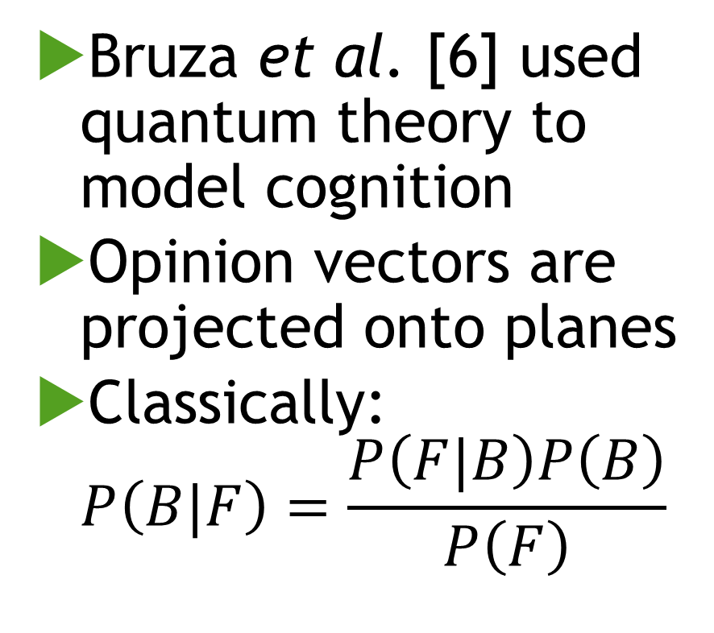
Adding behaviors
Bruza et al. [6] used quantum theory to model cognition
Opinion vectors are projected onto planes
Classically: $P\left(B|F\right)=\frac{P\left(F|B\right)P\left(B\right)}{P\left(F\right)}$
B
B
F
~F
~B
~B
S
S
P(B)
P(B|F)

Slide 29
Fuzzy navigation

Slide 30
Combing behaviors
Fuzzy logic can combine behaviors into meaningful action

Slide 31
Navigation revised
Perception
Modelling
Behavior
Environment
Can fuzzify any internal process

Slide 32
References
Brooks RA, “A Robust Layered Control System For A Mobile Robot”. IEEE Journal of Robotics and Automation, 1986; RA-2(1):14-23.
Rosenblatt JK and Payton DW, “A Fine-Grained Alternative to the Subsumption Architecture for Mobile Robot Control”. IEEE International Joint Conference on Neural Networks, 1989.
Arkin RC, “Motor Schema Based Navigation for a Mobile Robot: An Approach to Programming by Behavior”. IEEE International Conference on Robotics and Automation, 1987.
Khatib O, “Real-Time Obstacle Avoidance for Manipulators and Mobile Robots”. The International Journal of Robotics Research, 1986; 5(1):90-98.
Althaus P and Christensen HI, “Behavior Coordination for Navigation in Office Environments”. IEEE/RSJ International Conference on Intelligent Robots and Systems, 2002.
Bruza PD, Wang Z, and Busemeyer JR, “Quantum cognition: a new theoretical approach to psychology”. Trends in Cognitive Sciences, 2015; 19(7):383-393.

